Slide 1
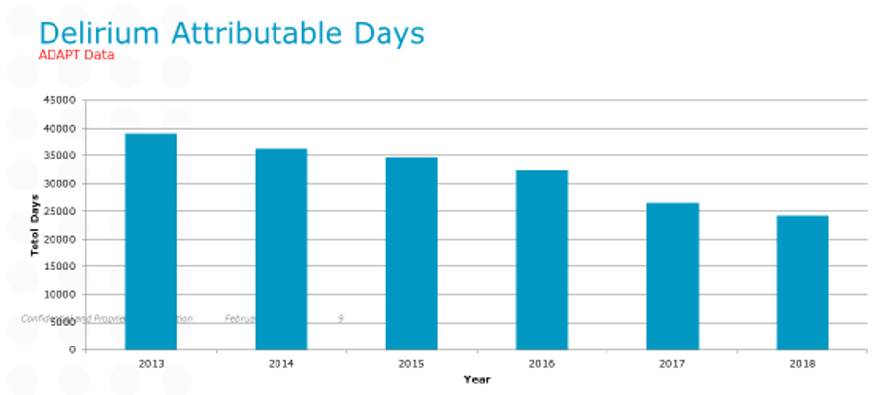
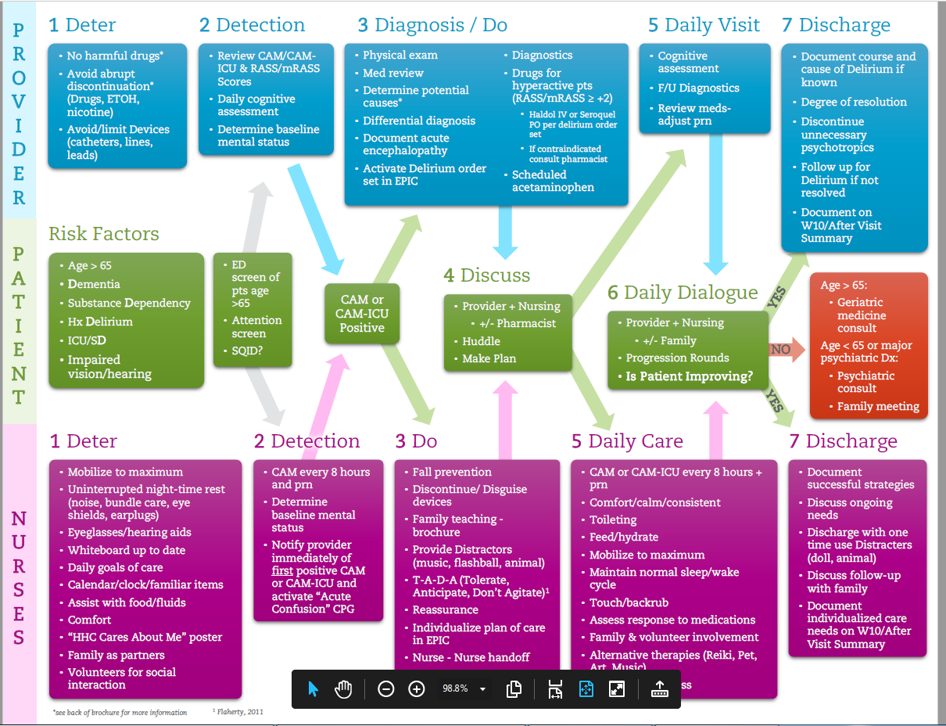
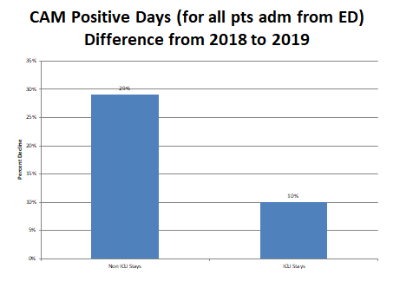
Delirium Outcomes in an Age Friendly Environment
Background: ADAPT Program
Christine Waszynski DNP, APRN, GNP-BC, FAAN
Robert Dicks, MD, FACP Hartford Hospital, Hartford CT
8% reduction annually; 40% reduction over 5 years 2012-2018.
Delirium attributable day= any day that any
inpatient had at least positive delirium screen (CAM or CAM-ICU). Patients are screened for delirium every 8 hours.
Delirium/Acute Encephalopathy Care Pathway
The Institute for Healthcare Improvement (IHI) sponsored “Age-Friendly Health System (AFHS)” initiative is focused on addressing 4 core concerns impacting health and welfare of older adults. These are (referred to as the “4 M’s”) 1. Mentation, 2. Medication, 3. Mobility, and 4. What Matters Most. Hartford Hospital was eager and able to engage as an early participant beginning rollout in late 2018 recognizing the complementary goals with programs in place; key being ADAPT (hospital-wide program focused on prevention and mitigation of delirium) and NICHE. We anticipated that participation in AFHS would promote additional team engagement and demonstration projects within defined clinical areas. Because our ADAPT program, which maintains a registry of Delirium outcomes (based on universal, continuous CAM, CAM-ICU assessments), has demonstrated a capacity to evaluate and monitor trends in delirium incidence and outcomes we are able to report on our experience with implantation of AFHS in Nov 2018.
In prior years 2012-2018, there was an average of an 8% decrease in CAM days year to year. Using admissions through ED (excludes transfer admissions) with or without transit through ICU from 2018-2019, we find significant reductions in CAM + days: a 29% reduction in patients never transiting through the ICU , and a 10% reduction for those who spent time in the ICU. We can attribute this (in part) to introduction of AFHS and engagement of care teams in prevention and mitigation.
Although elements of all 4 Ms concepts were included in our Delirium Care Pathway ADAPT program since 2012, integrating them into the 4M framework seemed to enhance their effectiveness. Staff verbalized a more comprehensive understanding of the prevention and management strategies for patients at increased risk of delirium. Hospital leadership was able to relate to the Age Friendly movement.
Superimposing the Age Friendly Health System framework on existing evidence based programs (including NICHE) can potentially enhance positive outcomes.
Reduction in CAM+ days with AFHS
Retrospective analysis from our ADAPT delirium program that systematically assessed all hospitalized patients from admission to discharge, during years 2018-2019. Both of these years were considered otherwise stable in terms of compliance with CAM screening and patient population characteristics.
AFHS interventions: What Matters; use of personalized profile at bedside; plain language daily goals; individualized therapeutic activities in room or multi-sensory stimulation area; reinforcing mobility and sleep enhancement measures; providing exercise plans with apparatus; avoiding high risk meds. Enhanced role of volunteer and family.
Reduction in CAM + days with AFHS
Berman, A., John, T., Foundation, A. H., Mate, K., & Pelton, L. (2018). Age-Friendly Health
Systems : The 4Ms : Interventions and Actions What Matters, 6(35), 87–88.
Fulmer, T. et al, (2019). Try This: Age-friendly health system: The 4ms. Try This: Best Practices
in Nursing Care of Older Adults.

